Slide 1

Thessaloniki .NET Meet up 31/03/2023 How BFF pattern can be used to improve security in SPAs

Slide 2
Speaker details – Charalampos Karypidis
Staff Software Engineer – remote based at cellarrats
Twitter : @xabikos
Github: www.github.com/xabikos
Mail : charalamposkarypidis@outlook.com

Slide 3
Agenda
Some History:
The cookie era
The token era
Problems
Getting the best of both worlds:
Backend for Frontend Pattern

Slide 4
Security issues in Web Apps - The cookie era
Most applications started as "classic web apps"
"spiced up" with JavaScript over time
Cookies have been used in the first place for authentication sessions
"just worked" for doing Ajax calls as well
Cross Site Request Forgery (CSRF) was discovered

Slide 5
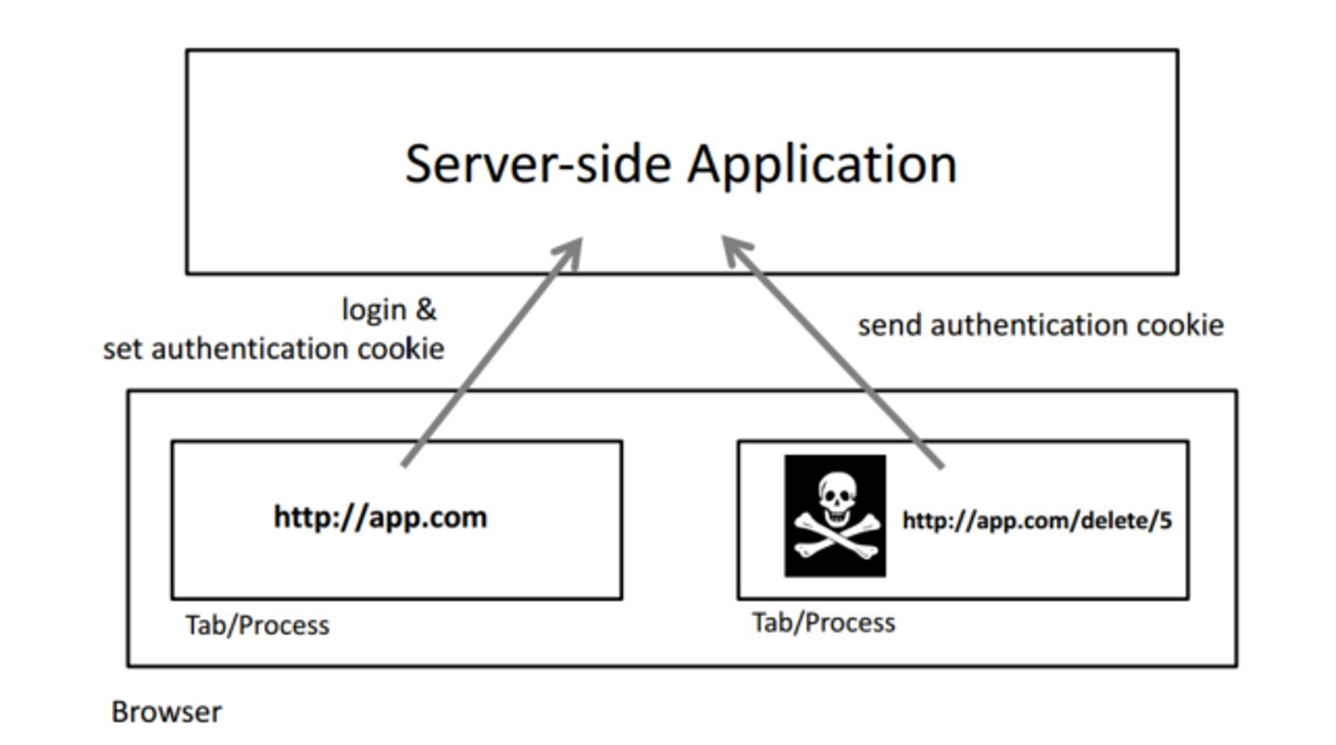
Threat: cross-site request forgery (CSRF)

Slide 6
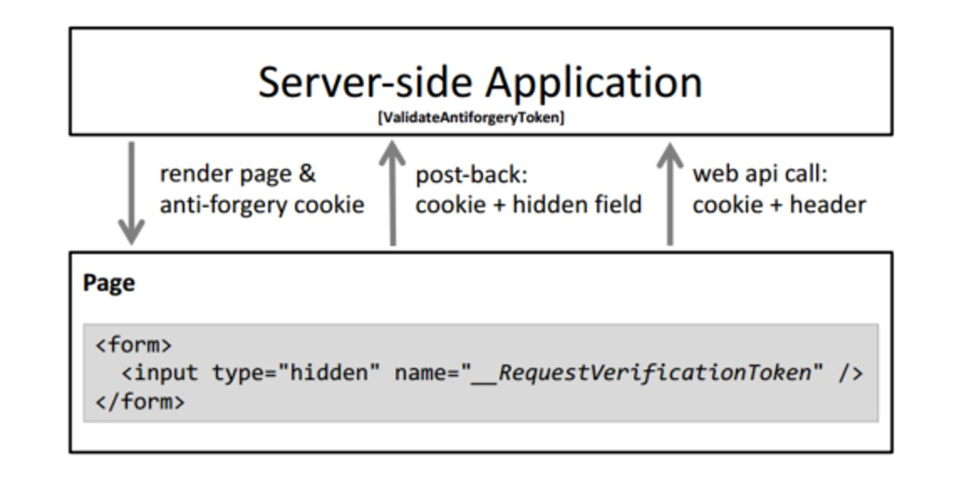
CSRF mitigation with anti-forgery tokens
Add explicit “credential” on every request

Slide 7
Security issues in Web Apps - The Token Era
With OAuth 2 the IETF tried to solve the cookie problem
encourage the use of token-based API calls in the browser
explicitly send tokens as opposed to automatic cookie transmission
OAuth 2 implicit flow to overcome same-origin restrictions
Lots of security compromises
token transport over URLs
token storage in the browser
Threat: Cross Site Scripting

Slide 8
Challenge: Token Transmission
Token transmission over URL is leaky
log files
browser history
referrer headers
implementation errors
proxies
No solution for token injection
Deprecated in OAuth 2.1
in favor of OAuth 2 Authorization Code Flow

Slide 9
Challenge: Token Storage
The browser does not have "secure" storage
by design storage is accessible via JavaScript
Code injection attacks allow exfiltration of storage content
injection attacks top threat on OWASP top ten
https://www.securityweek.com/google-releases-poc-exploit-browser-based-spectre-attack
That's why Implicit Flow does not allow refresh tokens

Slide 10
Challenge: Token and Session Management
Access tokens need to be managed
in absence of refresh tokens, the "silent renew" technique has been commonly used
utilizes iFrame with session cookie to request new tokens
Frontend applications needs session change notifications
JavaScript checkSession iFrame technique
relies on a session cookie in iFrame

Slide 11
Browser Changes (1/2)
Browsers more restrictive how they deal with 3rd party cookies
especially in iFrames
Safari
https://webkit.org/blog/10218/full-third-party-cookie-blocking-and-more/
Chrome
https://www.theverge.com/2021/6/24/22547339/google-chromecookiepocalypse-delayed-2023
Affected features
silent renew
session notifications
both JS and front-channel
End result: do your own token management with refresh tokens
refresh tokens end up in the browser
requires complicated token rotation techniques (that do not really work)
Session change notifications do not work anymore
back-channel notifications rarely implemented

Slide 12
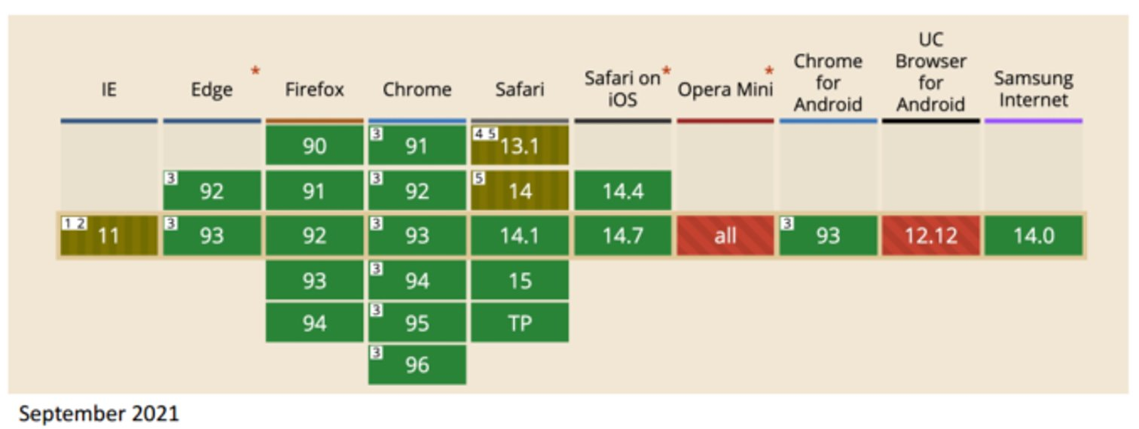
Browser Changes (2/2)
Browser vendors emphasize the "same site" sandbox and architecture
SameSite cookies
CORS for additional sandboxing

Slide 13
The BFF Pattern
Pros
Better security
Separation of Concerns
Easier to maintain and modify APIs
Better error handling in the frontend
Cons
Duplication and Lower Reuse
Yet another service to monitor and maintain

Slide 14
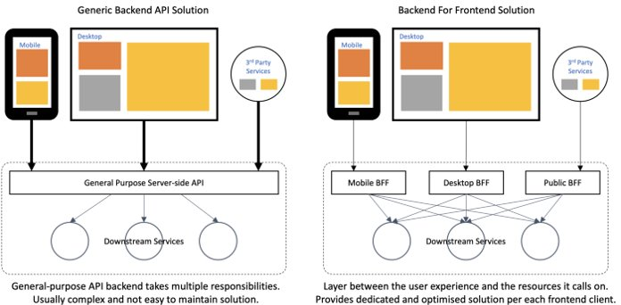

Slide 15
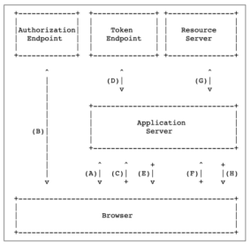
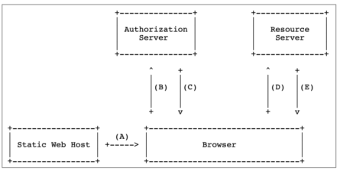
JavaScript Applications with a Backend
Application Server
initiates protocol flow
stores & manages tokens
proxies cross-domain calls
Browser
stores no tokens
uses cookies
JavaScript Applications without a Backend
Browser
initiates flow
store & manages tokens
makes all API calls
use no cookies

Slide 16


BFF Identity Server with Angular –pt1
Use the OIDC Client:
angular-oauth2-oidc
Configuration:
import { AuthConfig } from 'angular-oauth2-oidc';
export const authConfig: AuthConfig = {
issuer: 'https://demo.duendesoftware.com',
clientId: 'interactive.public',
responseType: 'code',
....
nonceStateSeparator: 'semicolon',
};

Slide 17
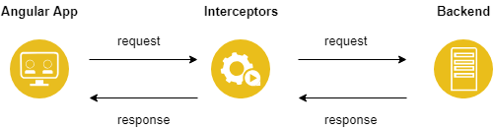
BFF Identity Server with Angular –pt2
Create a wrapper around AuthService
import { OAuthErrorEvent, OAuthService } from 'angular-oauth2-oidc’; @Injectable({ providedIn: 'root' })
export class AuthService {
.. //listen to events this.oauthService.events.subscribe((event) => { }
.. }

Slide 18

BFF Identity Server with Angular –pt3
Wrap everything in your module
import { OAuthErrorEvent, OAuthService } from 'angular-oauth2-oidc’; providers: [
{ provide: APP_INITIALIZER, useFactory: authAppInitializerFactory, deps: [AuthService], multi: true },
{ provide: AuthConfig, useValue: authConfig },
]

Slide 19
Useful links
Securing SPAs using the BFF Pattern (once and for all)
Cross Site Request Forgery (CSRF)​
Using the BFF pattern to secure SPA and Blazor Applications - Dominick Baier - NDC Oslo 2021

Slide 20
Thanks!​
​
​
Any Questions?​

